Slide 1
Scouts Môn and Cheshire Scouts
Young Leader Training – Module C
Cymru
Module C- That’s the way to do it!
Notes:
Links with Mission One

Slide 2

Scouts Môn and Cheshire Scouts
Young Leader Training – Module C
      Objectives:
Understand and be able to talk about how young people learn effectively
Demonstrate an ability to pass on skills to younger people
Understand and talk about different learning styles
Have confidence in using different training techniques
Notes:
It’s always good to start with objectives so we know what we are going to be doing for the session.
Talk through the objectives and remember to revisit them at the end to see if we have achieved everything.

Slide 3
Scouts Môn and Cheshire Scouts
Young Leader Training – Module C
Cymru
Activity one – Can you draw it?

Slide 4
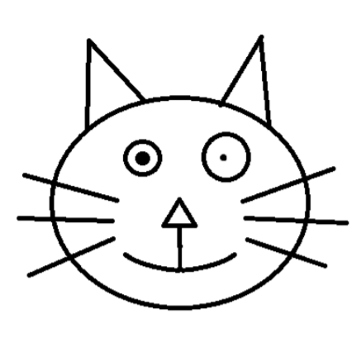
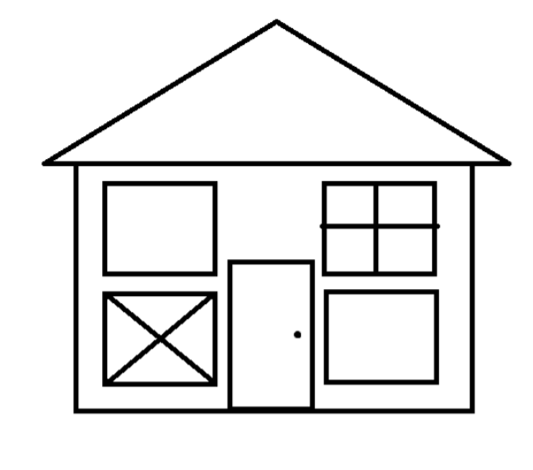
Scouts Môn and Cheshire Scouts
Young Leader Training – Module C
Notes:
The Artist Activity - approx. 10 minutes
Ask the YLs to draw the images above, giving them minimal instructions. Compare drawings to what they should look like, then discuss what they think of this learning method.
This is pure iteration – it may be suitable for older sections, but isn’t generally favoured as some YP can get discouraged if they don’t know what to do.

Slide 5
Scouts Môn and Cheshire Scouts
Young Leader Training – Module C
Cymru
Activity two – I do, we do, you do

Slide 6
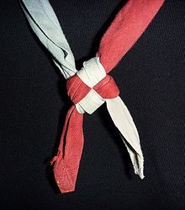

Scouts Môn and Cheshire Scouts
Young Leader Training – Module C
      I do a knot, we do a knot, you do a knot
Notes:
I do, we do, you do (suitable for groups of all sizes, approx. 25 minutes)
Each ESYL should have a piece of string/wool/shoelace etc. Start by showing them how to tie a knot. The ESYLs should watch you tie it carefully. Next, ask the ESYLs to fasten the knot at the same time, creating the knot together. Finally, they should fasten the knot on their own. This activity teaches the method of I do, we do, and you do.
Knot in this slide can be swapped out for whatever know (or other activity) you choose.
Top tip: teaching sign language instead of knots can be another good way to cover this method. Another alternative would be to use Smarties, demonstrating a pattern to the ESYL using the different colours of the different smartie sweets. The ESYLs should attempt to create the pattern at the same time as you, and then attempt to do it themselves from memory.

Slide 7
Scouts Môn and Cheshire Scouts
Young Leader Training – Module C
Cymru
Activity Three – How do I do it?

Slide 8
Scouts Môn and Cheshire Scouts
Young Leader Training – Module C
      I’ve lost my memory – can you help me?
      How do I:
      Write an email?
      Tie my laces?
      How do I make a cup of tea?
Notes:
How do I do it?
You’ve forgotten how to do simple things. Ask the YLs to instruct you on how to do the simple tasks, taking everything they say very literally.
This will help them realise that you have to be very precise with instruction, as it can be misinterpreted.

Slide 9
Scouts Môn and Cheshire Scouts
Young Leader Training – Module C
Cymru
Discussion – Which learning style is the best?
Notes:
Regroup and discuss the following points:
all methods described have both advantages and disadvantages
talking something through can get a message across to lots of people at once, but often misses out on the detail
Using a diagram or paper copy ensures that everyone gets the same message
demonstrating a skill or technique has visual impact, but you can only use this technique in small groups
demonstrating with material has additional visual impact
in terms of learning,, demonstrating something by doing has more effect than merely seeing or listening to something
in general, younger members respond better to doing something simple with coloured bits and pieces
as members get older, written and printed material can be useful
talking to groups has its limitations with any age group, but can be essential in describing the rules of games (as long as they are simple)
small groups lend themselves to demonstrations and tend to respond well to a hands-on approach to learning
larger groups require visual aids that everyone can see, such as slides, OHPs or PowerPoint presentations, along with a simple and effective verbal message
leadership is easier to do effectively in a small group, especially if everyone is involved in doing things themselves and taking an active role
the larger the group, the more difficult teaching becomes, as boredom and disinterest become issues
using directed questions to group members could be useful, but remember not to pick on any one member all the time
if boredom and disinterest are becoming a problem, maybe you need to rethink the method you are using to get your message across (How can you bounce back? Is there a different way you could approach things?)

Slide 10
Scouts Môn and Cheshire Scouts
Young Leader Training – Module C
Cymru
Notes:
Summarise the module by revisiting the objectives. Ask the ESYLs whether they feel they have covered all of the objectives satisfactorily. Before they go, carry out a review or an evaluation of the session.
This module links to the first Mission

